Slide 1
Online GPS II/MAPP
Meetings 1 – 10

Slide 2
Meeting 5 Helping Children and Youth Learn to Manage Their Behaviors

Slide 3
License Rights to OCFS
Center for Development of Human Services, Institute for Community Health Promotion, SUNY Buffalo State acknowledges the State of New York’s and the Office of Children and Family Services’ royalty-free, non-exclusive and revocable license to reproduce, publish, distribute, or otherwise use any and all material herein for the limited purpose of training GPSII/MAPP Leaders and for as long as such materials and such training are deemed appropriate by NYS OCFS.
The Children’s Alliance of Kansas (CAOK) is the current national owner of the copyrighted “toolbox” of MAPP programs. NYS Office of Children and Family Services (NYS OCFS)/Center for Development of Human Services (CDHS) has permission from CAOK to provide MAPP programs (GPSII/MAPP, Caring For Our Own, Deciding Together, Shared Parenting, Mini-MAPP, and Child Sexual Abuse) to certify leaders through leader certification workshops and directly to foster/adoptive parents in New York State.
In order to better meet the needs of children and families in New York State, PS-MAPP was revised in 2004 and renamed GPSII/MAPP. Further revisions were made in 2005 after considering the feedback from MAPP Leaders throughout the state, and minor revisions and reformatting occurred in 2009. Significant revisions to the content and updating to reflect best practice and legal changes in New York State were made and approved by NYS OCFS in 2012 for this edition.
© 2009 Children’s Alliance of Kansas. Revised with permission NYS OCFS.

Slide 4
Rules of the Road
Placeholder

Slide 5
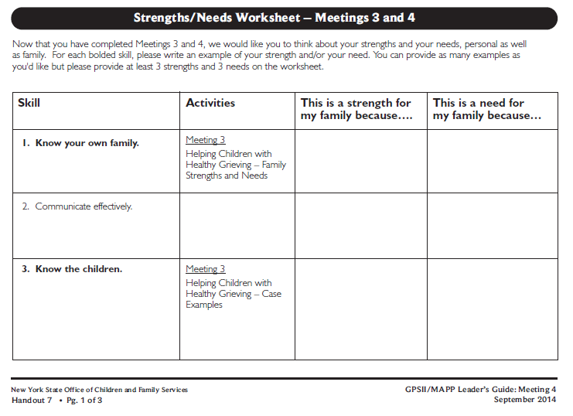
Roadwork from Last Meeting:
Meeting 4 Handout 7, Strength/Needs Worksheet

Slide 6
Feedback for Leaders and the Group
What are the leaders doing especially well?
What are some things the leaders could change to improve the meetings?
What are we doing well as a group?
What are things we might change as a group to improve the meetings?

Slide 7
Twelve Skills for Successful Fostering and Adopting
Know your family
Communicate Effectively
Know the children
Build strengths, meet needs
Work in partnership
Be loss and attachment experts
Manage behaviors
Build connections
Build self-esteem
10. Assure health and safety
Assess impact
Make an informed decision

Slide 8
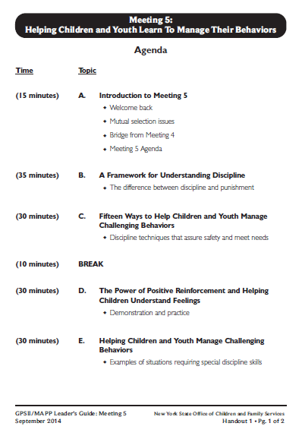
Let’s look at: Handout 1

Slide 9
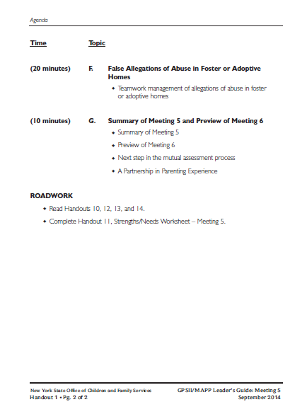

Slide 10
Cycle of Need: Attachment
Need
Expression
(Behavior)
Intervention
Relaxation

Slide 11
“Carlos” Case Example
Carlos is five years old.
His mom is 23 years old, has two younger children, is a single parent with very little support.
When Carlos wants his mom’s attention and some physical affection, he “acts up” by having a temper tantrum.

Slide 12
“Carlos” Case Example (continued)
His mom gets upset with Carlos and hits him repeatedly while screaming at him.
Hitting continues until Carlos is bruised and sore.
Carlos’s mom feels guilty.
She hugs and kisses Carlos, then takes him to store to buy him ice cream and candy.

Slide 13
What need was Carlos expressing?
Need
Expression
(Behavior)
Intervention
Relaxation

Slide 14
Cycle of Need: Carlos hugs mom
Need
Expression
(Behavior)
Intervention
Relaxation?
Attention &
Affection
Hug mom
Mom pushes him away

Slide 15
Cycle of Need: Carlos brings a game to mom
Need
Expression
(Behavior)
Intervention
Relaxation?
Attention &
Affection
Bring a game to play
Mom scolds him and tells him to leave the room

Slide 16
Cycle of Need: Carlos has a tantrum
Need
Expression
(Behavior)
Intervention
Relaxation?
Attention &
Affection
temper tantrum
Hitting & yelling
Hugs, kisses,
ice cream & candy

Slide 17
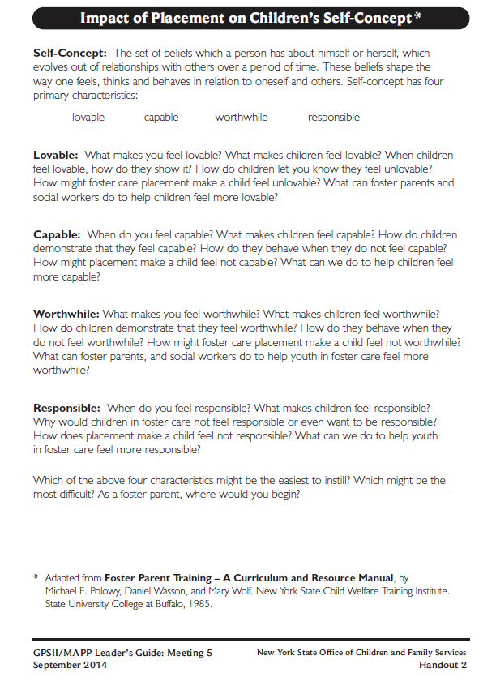
Let’s look at: Handout 2

Slide 18
Four Characteristics of Self Concept
Lovable
Capable
Worthwhile
Responsible

Slide 19
Let’s look at:
Handout 3

Slide 20
Physical Punishments We Have Used or Have Been Used on Us:

Slide 21
Reasons Physical Punishment Is Used:

Slide 22
Reasons Physical Punishment Might Not Work or Might be Harmful for the Child Who has Experienced Abuse and Neglect:

Slide 23
Does Physical Punishment Teach?
Physical punishment such as ________________ may be used by a parent because_____________________,
but does it teach children who have been abused and neglected…
to understand feelings and needs?
to understand the connection between feelings and behaviors?

Slide 24
Does Physical Punishment Teach?
Physical punishment such as ________________ may be used by a parent because ________________,
but does it teach children who have been abused and neglected…
to learn healthy ways to get needs met (problem solve)?

Slide 25
Does Physical Punishment Teach?
Physical punishment such as ________________ may be used by a parent because ________________,
but does it teach children who have been abused and neglected…
to feel good about their relationship with adults and other children?
to feel good about themselves (lovable, capable, worthwhile and responsible)?

Slide 26
Let’s look at: Handout 4

Slide 27
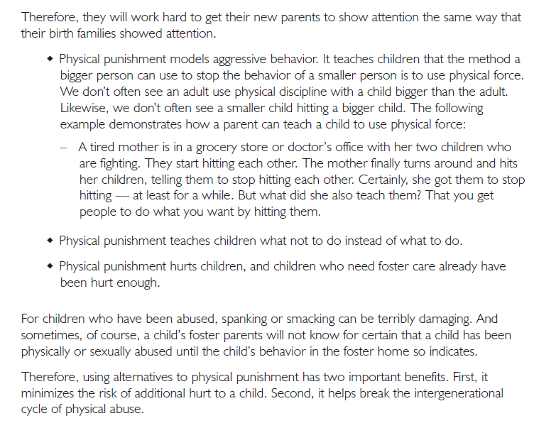

Slide 28
A behavior that pushes my button…
For a toddler:
For a school-age child:
For a teenager:

Slide 29
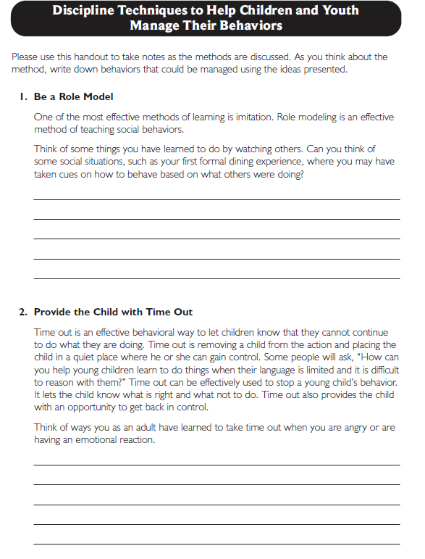
Let’s look at:
Handout 5

Slide 30
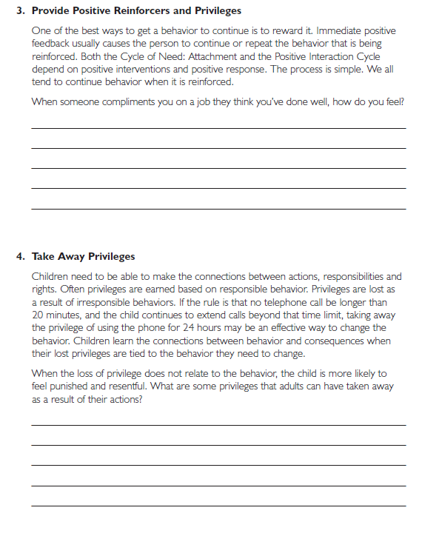

Slide 31
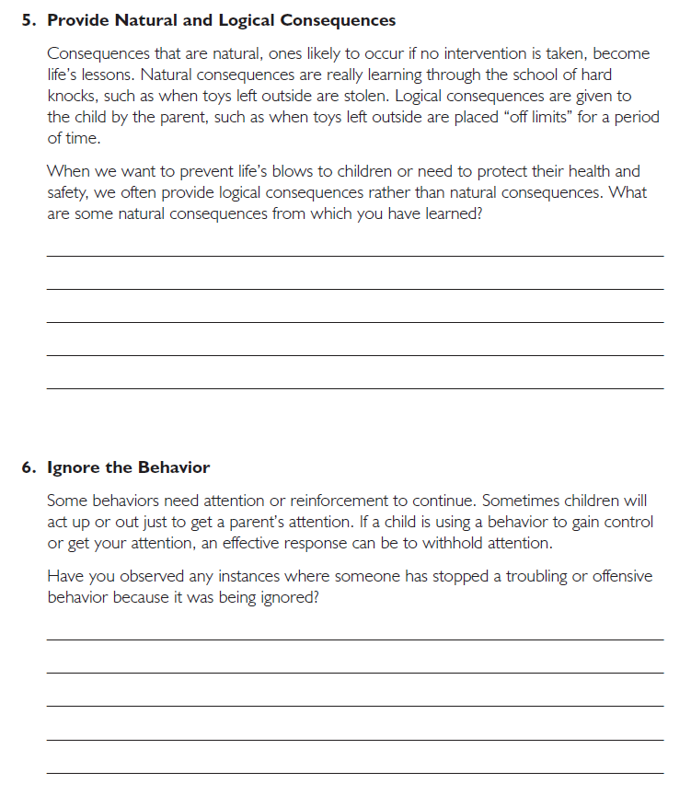

Slide 32
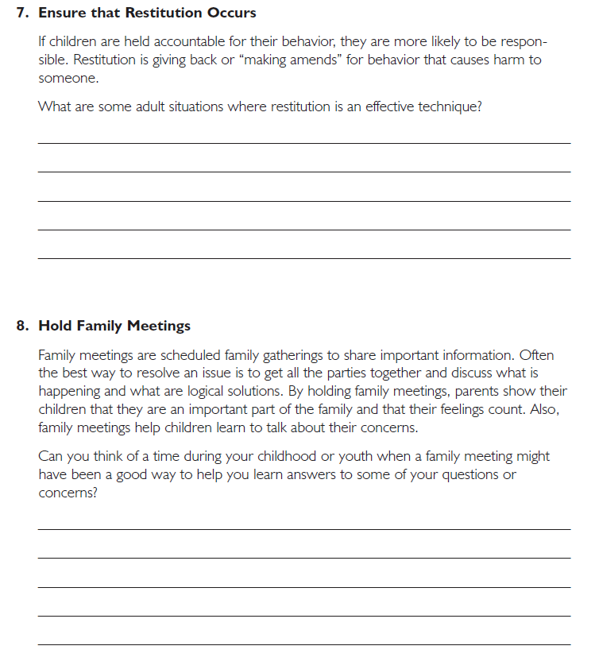

Slide 33
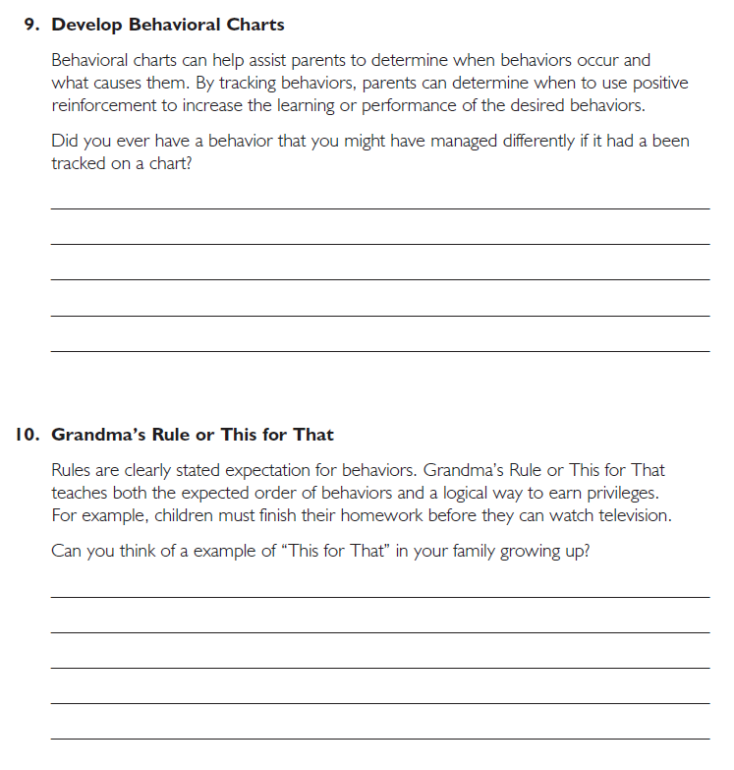

Slide 34
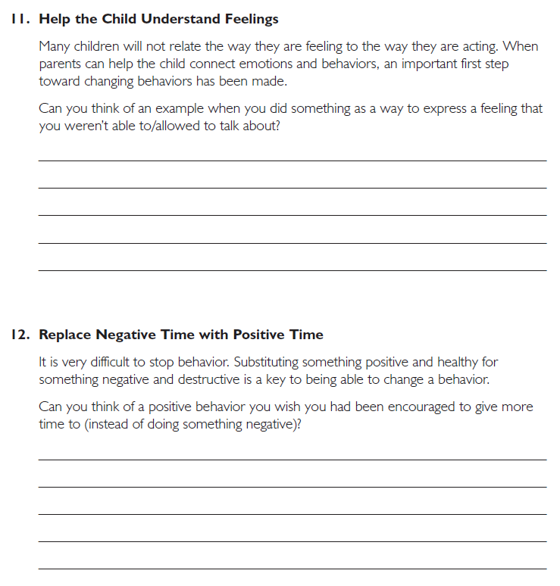

Slide 35
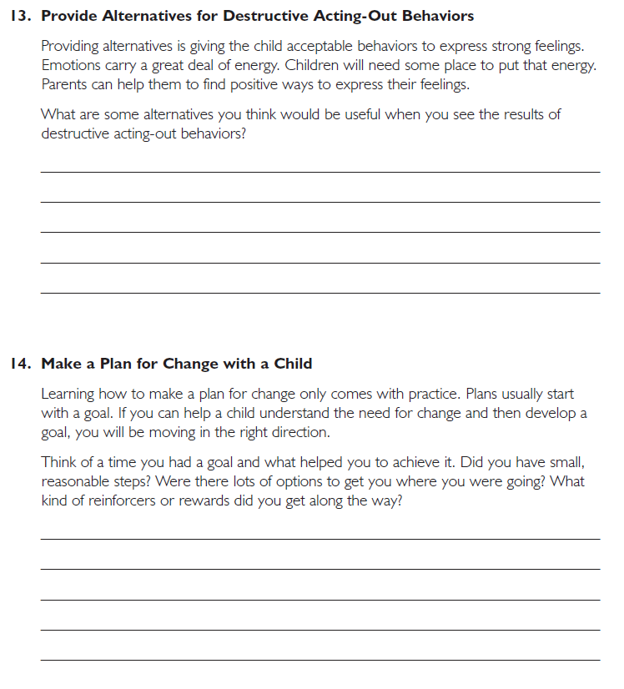

Slide 36
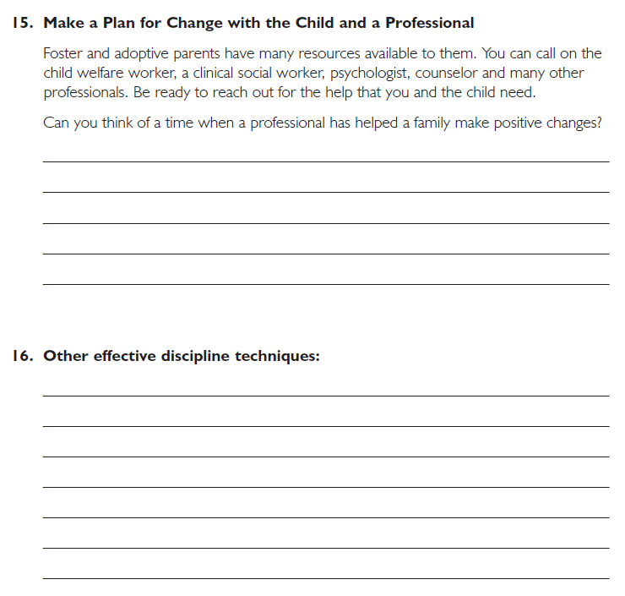

Slide 37
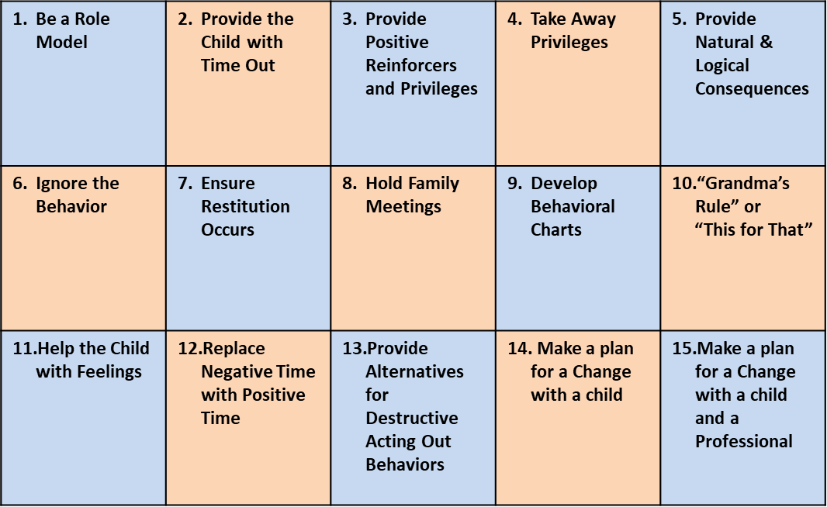

Slide 38
Demonstration:
The Power of Positive Reinforcement

Slide 39
Crack the Code!
1 | 2 | 3 | 4 | 5 | 6 | 7 | 8 | 9 | 10
20 | 19 | 18 | 17 | 16 | 15 | 14 | 13 | 12 | 11
21 | 22 | 23 | 24 | 25 | 26 | 27 | 28 | 29 | 30
40 | 39 | 38 | 37 | 36 | 35 | 34 | 33 | 32 | 31

Slide 40
Code
16, 19, 29

Slide 41
You did it!!!

Slide 42
What We Did to Teach the Desired Behavior:

Slide 43
Demonstration:
Help the Child Understand Feelings

Slide 44
Twelve Skills for Successful Fostering and Adopting
Know your family
Communicate Effectively
Know the children
Build strengths, meet needs
Work in partnership
Be loss and attachment experts
Manage behaviors
Build connections
Build self-esteem
10. Assure health and safety
Assess impact
Make an informed decision

Slide 45
Active Listening

Slide 46
Names of Feelings

Slide 47
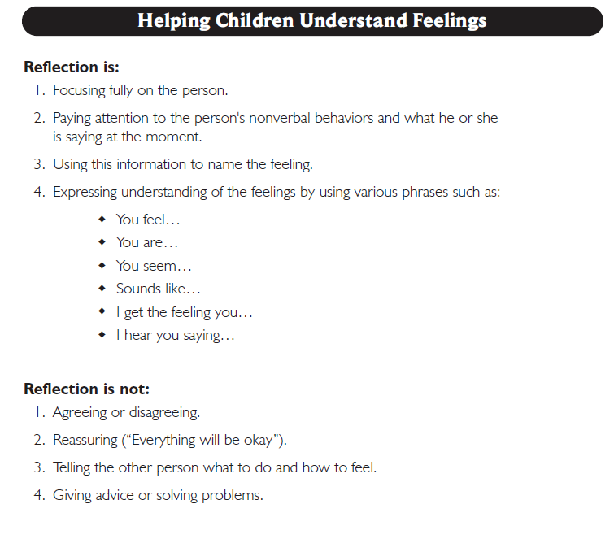
Let’s look at: Handout 6 (Page 1)

Slide 48
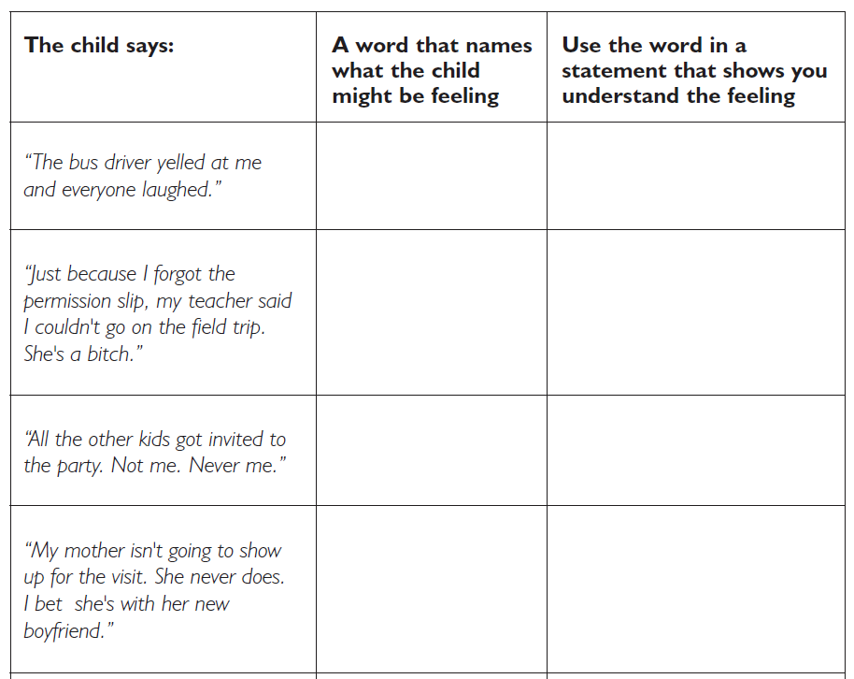
Let’s look at: Handout 6 (Page 2)

Slide 49
Let’s look at: Handout 6 (Page 2)
A word that names
What the parent might be feeling
Use the word in a statement that shows you understand the feeling

Slide 50
Cycle of Need: Attachment
Need
Expression
Intervention
Relaxation

Slide 51
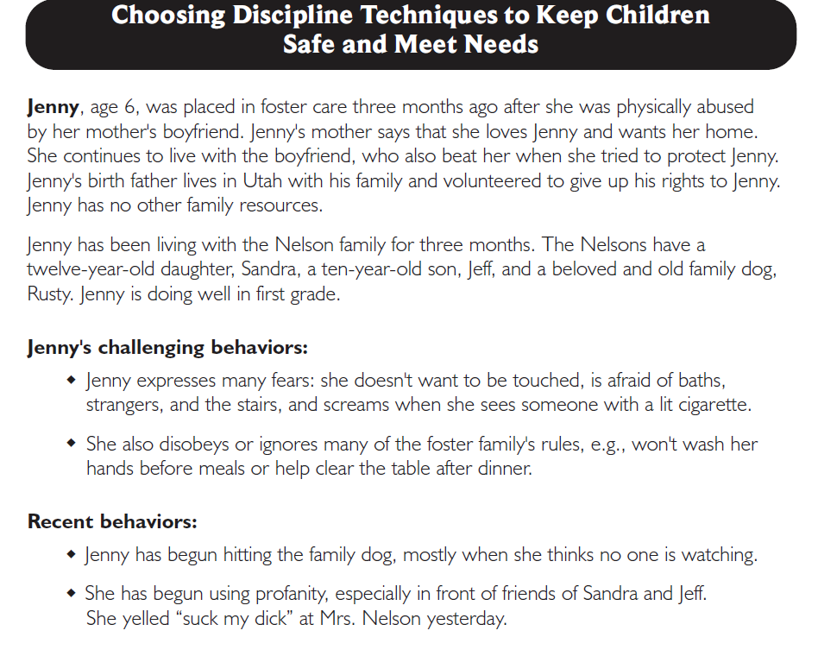
Let’s Look at: Handout 7 (page 1)

Slide 52
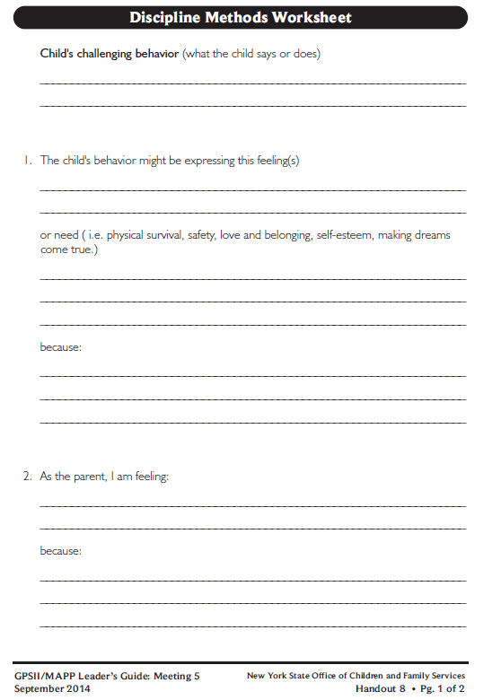
Let’s look at:
Hitting the family dog
Handout 8

Slide 53
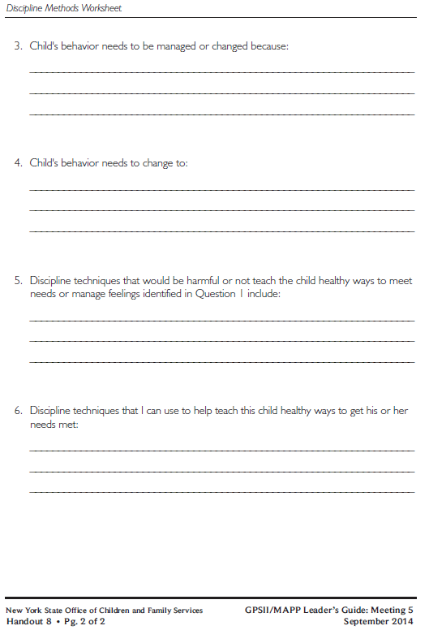

Slide 54
Twelve Skills for Successful Fostering and Adopting
Know your family
Communicate Effectively
Know the children
Build strengths, meet needs
Work in partnership
Be loss and attachment experts
Manage behaviors
Build connections
Build self-esteem
10. Assure health and safety
Assess impact
Make an informed decision

Slide 55
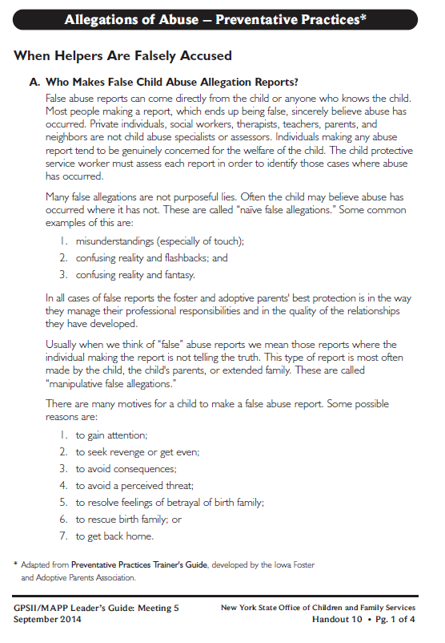
Let’s look at:
Handout 10

Slide 56
False Allegations of Abuse
in Foster and Adoptive Homes
Naïve False Allegations
made when a child is confused or mixes fantasy with reality.
Manipulative False Allegations
made by a child, youth or adult in order to get desired behavior from foster or adoptive family or agency.

Slide 57
Motives for a Child to Make a False Report
to gain attention
to seek revenge or get even
to avoid consequences
to avoid a perceived threat
to resolve feelings of betrayal of birth family
to rescue birth family
to get back home

Slide 58
Motives for Parents to Make a False Report
distrust of foster parents
jealousy
avoid perceived threat to their child
misdirected anger
in a position of weakness/sadness
in grief and loss cycle
to get their child back home

Slide 59
High Risk Situations for a False Allegation
child is under a lot of stress;
child is experiencing a lot of anxiety;
upcoming court date with a possible decision for the child to return home;
poor team relationship between the social worker, foster parent and birth family;
infrequent home visits; and
sight, sound, touch, smell, etc. that reminds the child of past abuse

Slide 60
Responding to Allegations
Keep perspective
Be Honest
Cooperate
Write Things Down
Ask Questions
Get Support

Slide 61
Roadwork Reading
Read Handout 7, “Joey”, “Jeryce” and “Karen” Case Examples and think about selecting effective discipline techniques for them.
Read Handouts 10, 12, 13, and 14
Complete Handout 11, Strengths/Needs Worksheet for Meeting 5

Slide 62
It’s Time for a PIP!
Partnership
In
Parenting Experience

